Slide 1

Owned By Statistics:
Attacks on Machine Learning and How to Use MLOps to Defend
David Aronchick
Head of OSS Machine Learning Strategy, Azure Machine Learning
@aronchick - he/him

Slide 2





Microsoft ML breakthroughs
Vision
Speech
Language
Switchboard
Meeting speech
96%
RESNET vision test 152 layers
5.1%
Switchboard speech recognition test
69.9%
MT research system
88.5%
SQuAD reading comprehension test
Broadcast speech
Switchboard cellular
IBM Switchboard
1993
2000
2006
2010
2017
2016
Object recognition Human parity
2017
Speech recognition Human parity
2018
Machine translation Human parity
2018
Machine reading comprehension Human parity
Notes:
3-4 minutes

Slide 3








ML at Microsoft
Microsoft 365
Research
Notes:
4-5 minutes

Slide 4

But ML is HARD!
Notes:
7 minutes

Slide 5
Building a model
Notes:
7 – 8 minutes

Slide 6
Data ingestion
Data analysis
Data transformation
Data validation
Data splitting
Trainer
Building a model
Model validation
Training at scale
Roll-out
Serving
Monitoring
Logging
Notes:
8-10 minutes

Slide 7
Ok, but, like, I’m a data scientist. IDGAF I don’t care about all that.
Notes:
10 minutes

Slide 8
Yes You Do!
Notes:
10 minutes

Slide 9
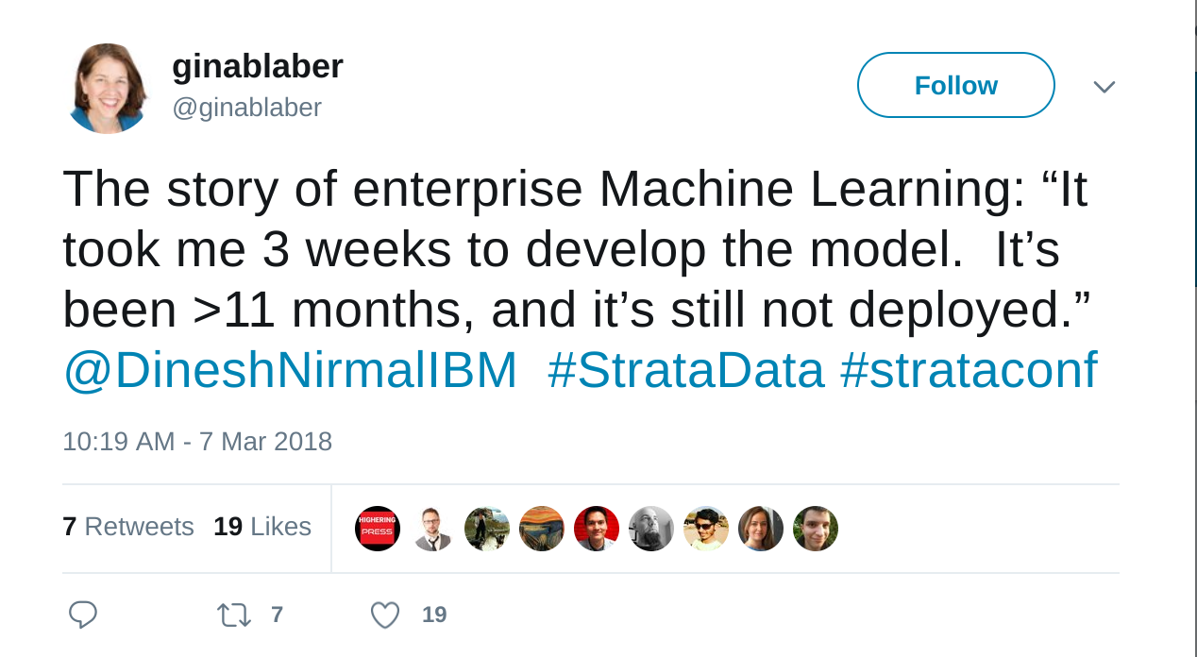
Notes:
34m

Slide 10
MLOps
Notes:
15m

Slide 11
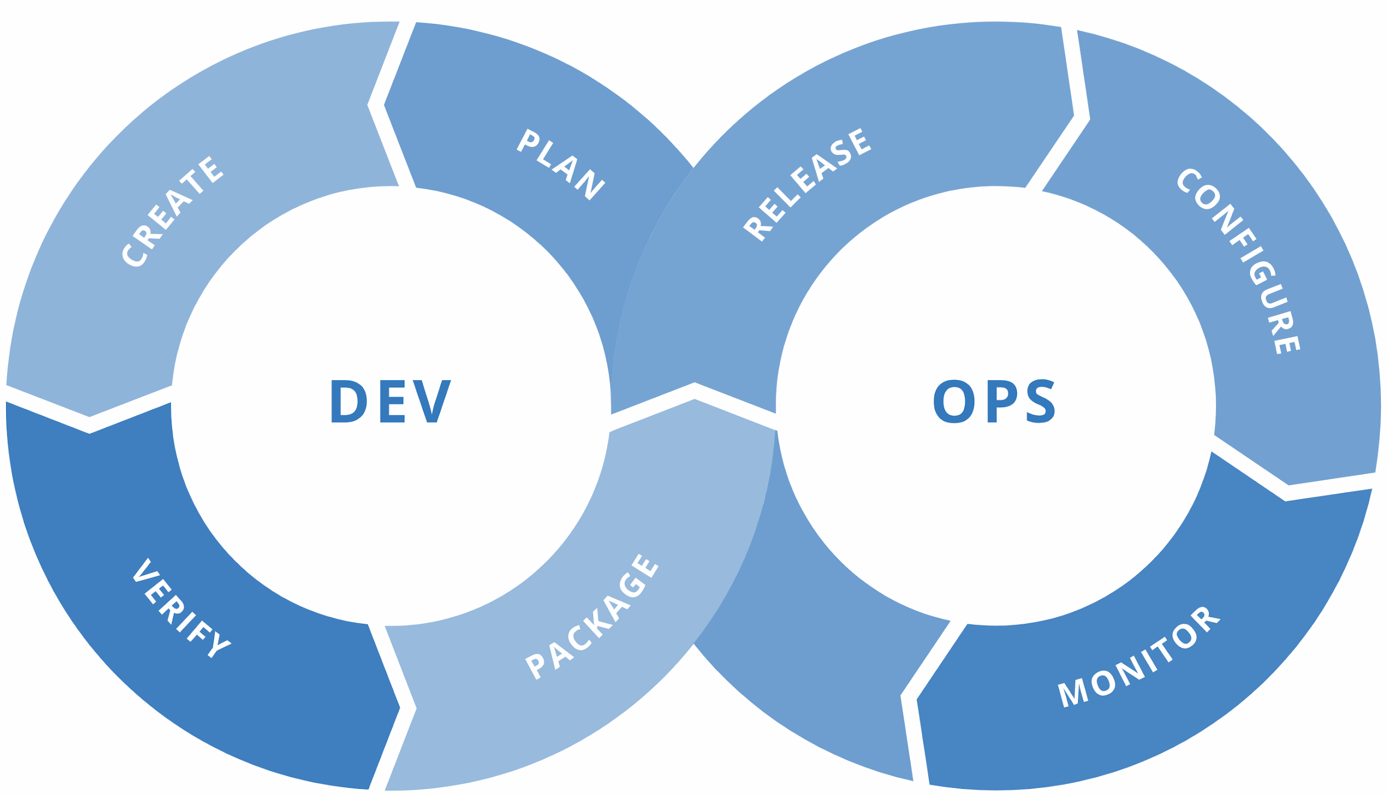
MLOps = ML + DEV + OPS
ML
Experiment
Data Acquisition
Business Understanding
Initial Modeling
Develop
Modeling
Operate
Continuous Delivery
Data Feedback Loop
System + Model Monitoring
+ Testing
Continuous Integration
Continuous Deployment
Notes:
15m-17m

Slide 12
Wasn’t This Talk Supposed to be About Security?
Notes:
34m-40m

Slide 13
MLOps is The Baseline for Security
Notes:
34m-40m

Slide 14
But… it’s Just Math, How Bad Could It Be?
Notes:
34m-40m

Slide 15
Three Types of Attacks We’ll Talk About Today
Attacker Gets Your ML to Lie To You
Attacker Takes Your Models
Attacker Finds Out About Hidden Data
Notes:
34m-35m

Slide 16
Three Types of Attacks We’ll Talk About Today
Attacker Gets Your ML to Lie To You
Attacker Takes Your Models
Attacker Finds Out About Hidden Data
Notes:
34m-35m

Slide 17
Attacker Gets Your ML to Lie To You
Notes:
34m-40m

Slide 18






Circle Detector
Train Data
Ingest
Engineer & Split
Train
Serve
Test Data
Notes:
34m-35m

Slide 19
Circle Detector
Train Data
Ingest
Engineer & Split
Train
Serve
Test Data
It’s a circle!
Notes:
34m-35m

Slide 20
Circle Detector
Train Data
Ingest
Engineer & Split
Train
Serve
Test Data
It’s a circle!
??????
Notes:
34m-35m

Slide 21
???????
Notes:
34m-35m

Slide 22

Well, that green thing has all the same pixels as a circle… it’s a circle!
Notes:
34m-35m

Slide 23


Notes:
34m-35m

Slide 24
Surely, Advanced Models are Better … Right?
Notes:
https://arxiv.org/pdf/1602.04938.pdf

Slide 25
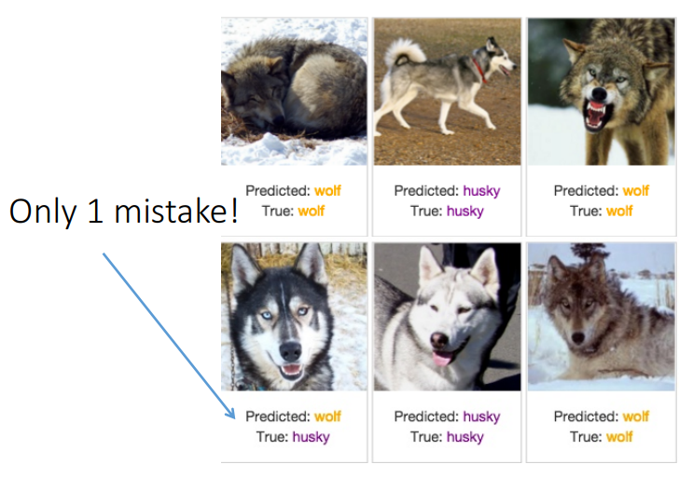
“Why Should I Trust You?” Explaining the Predictions of Any Classifier - Ribeiro, Singh, Guestrin

Slide 26
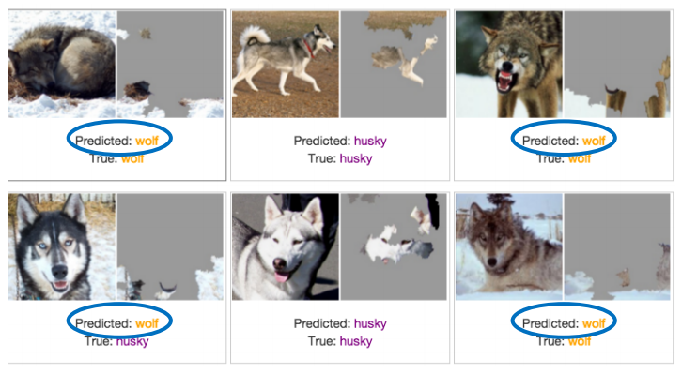
The Explanation Reveals Why

Slide 27
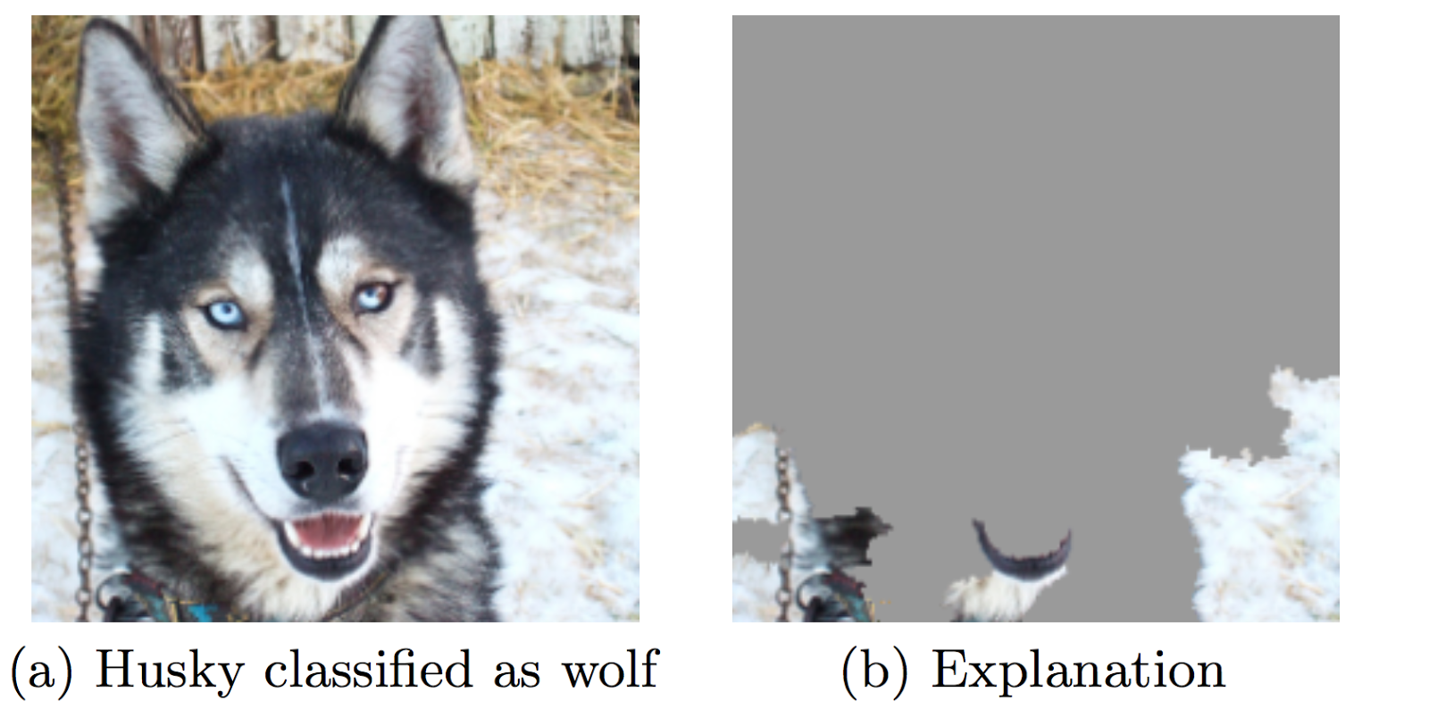

The Explanation Reveals Why
It’s a SNOW Detector

Slide 28


Adversarial Inference
Speed Limit
Rifle
Synthesizing Robust Adversarial Examples - Anish Athalye, Logan Engstrom, Andrew Ilyas, Kevin Kwok
Notes:
© Microsoft Corporation. All rights reserved. MICROSOFT MAKES NO WARRANTIES, EXPRESS, IMPLIED OR STATUTORY, AS TO THE INFORMATION IN THIS PRESENTATION.
http://proceedings.mlr.press/v80/athalye18b/athalye18b.pdf
Synthesizing Robust Adversarial Examples - Anish Athalye, Logan Engstrom, Andrew Ilyas, Kevin Kwok

Slide 29
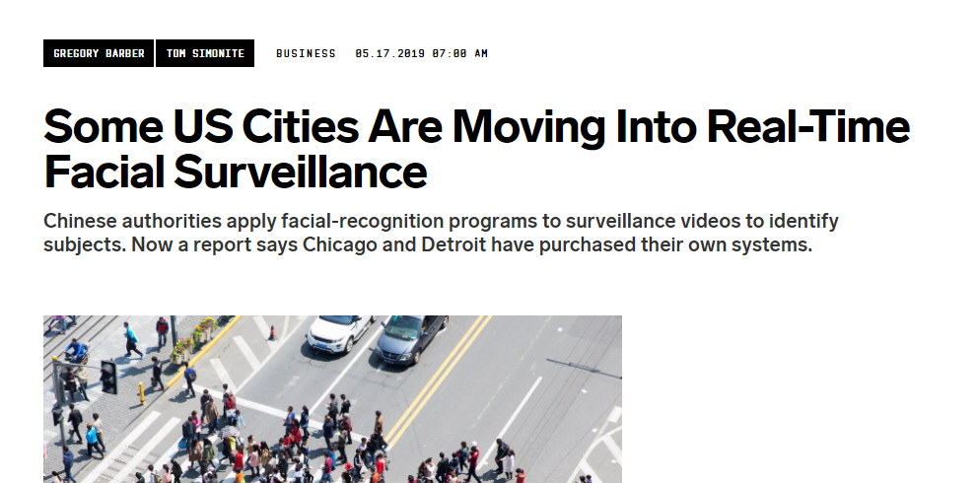
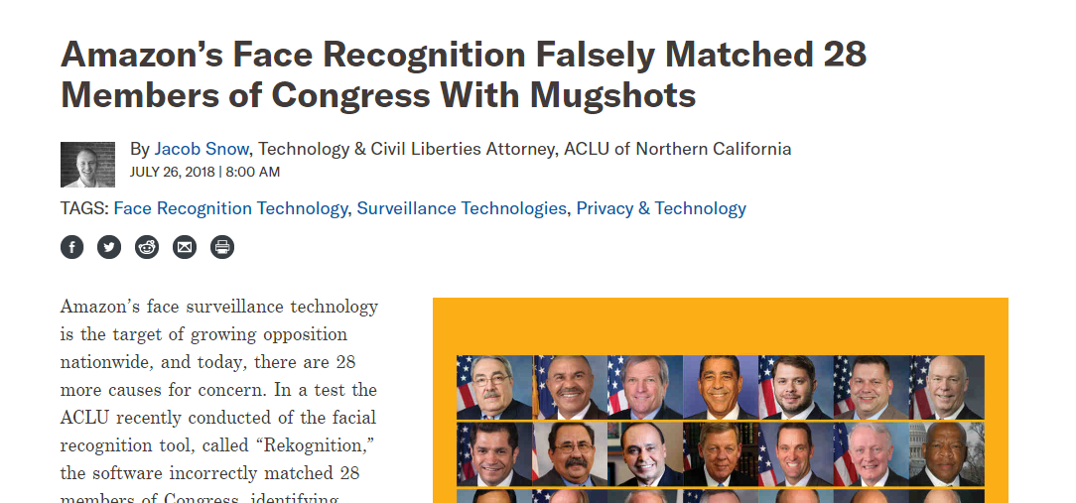

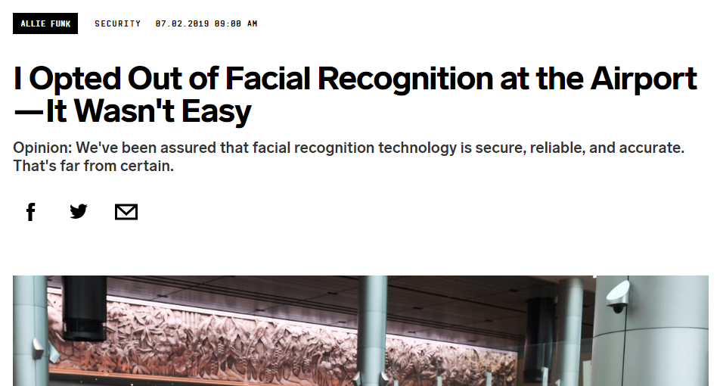
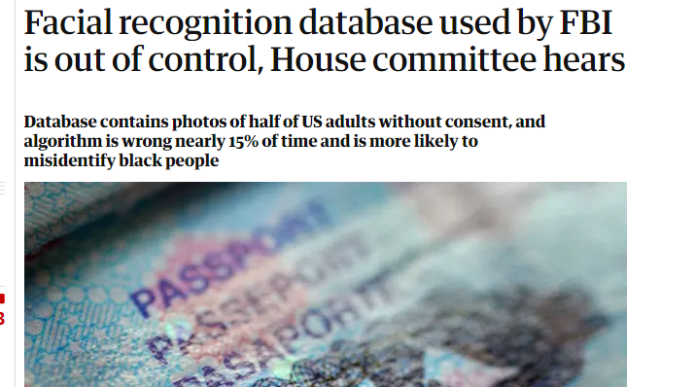
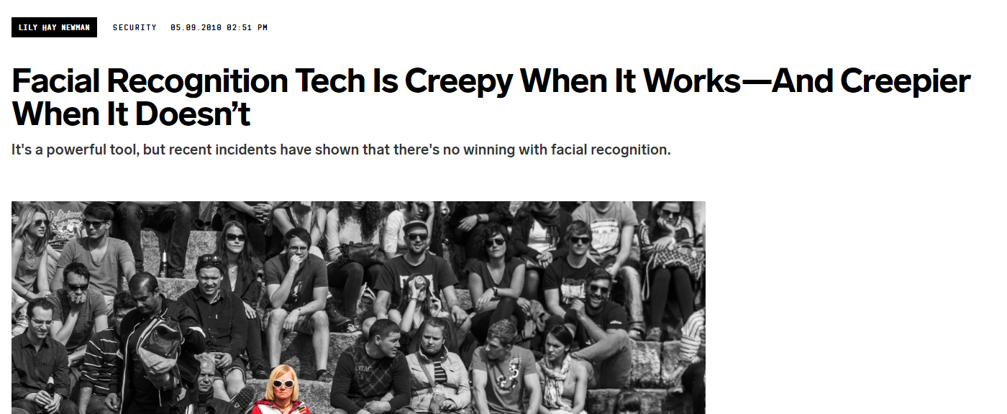
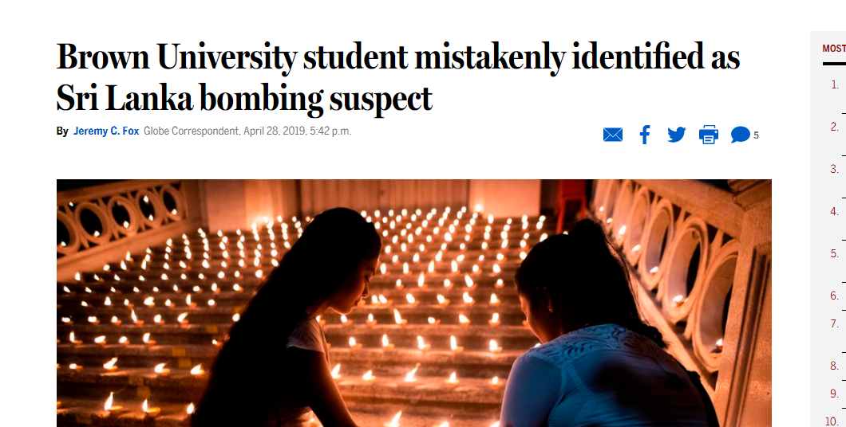
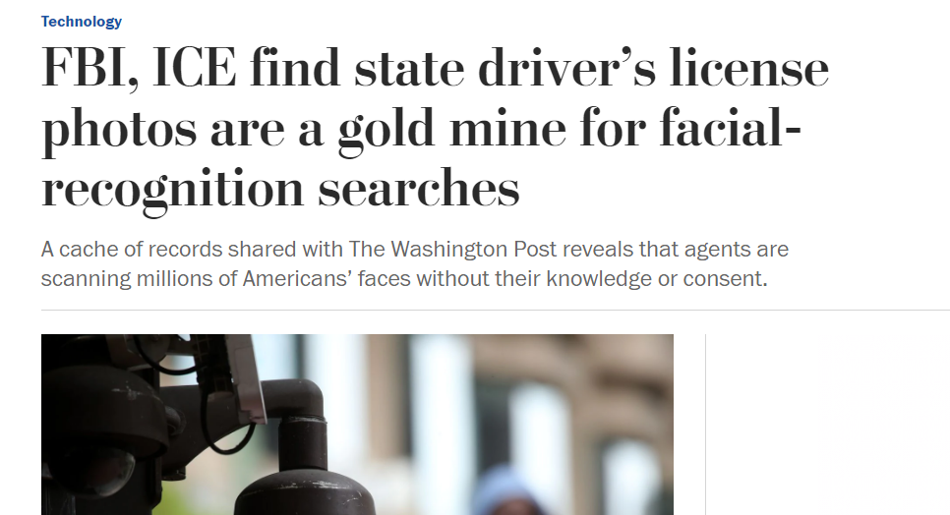
Who cares…
Notes:
https://www.wired.com/story/best-algorithms-struggle-recognize-black-faces-equally/
https://www.aclu.org/blog/privacy-technology/surveillance-technologies/amazons-face-recognition-falsely-matched-28
https://www.wired.com/story/facial-recognition-tech-creepy-works-or-not/
https://www.bostonglobe.com/metro/2019/04/28/brown-student-mistaken-identified-sri-lanka-bombings-suspect/0hP2YwyYi4qrCEdxKZCpZM/story.html
https://www.wired.com/story/facial-recognition-everywhere-should-you-worry/
https://www.wired.com/story/some-us-cities-moving-real-time-facial-surveillance/
https://www.theguardian.com/technology/2017/mar/27/us-facial-recognition-database-fbi-drivers-licenses-passports
Database contains photos of half of US adults without consent, and algorithm is wrong nearly 15% of time and is more likely to misidentify black people

Slide 30
Terrified yet?
Notes:
https://arxiv.org/pdf/1602.04938.pdf

Slide 31
Tools to Defend
Better Evaluation Metrics
Attack Your Own Models FIRST
Different Models
Moar edge cases
Detect Bad Data
Train Data
Ingest
Engineer & Split
Train
Serve
Test Data
Alerting and Monitoring
Continuous Training Adding in Production Data

Slide 32
But How?

Slide 33
MLOps Pipelines!

Slide 34
Building a Pipeline
Use a CI/CD Platform - e.g. GitHub Actions, Jenkins
Add modular components
Loosely coupled, microservice oriented
Mix and match! (e.g. on-prem, cloud, self-hosted)
Use pre-built solutions - http://mlops-github.com/
Measure, measure, measure and UPDATE
Models go stale QUICKLY
Don’t let adversaries be the ones to alert you that your systems are out of date

Slide 35

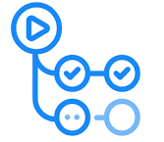





Experiment
Compare
Search
Train (Locally)
GitHub Actions
Code Check- in
Process
Data
Feature Engineering
Training
Package
Serve
Start
Finish
Start
Finish
Clean
Tokenize
Analyze
Train
Finalize
METADATA STORAGE

Slide 36
Experiment
Compare
Search
Explainer
Train (Locally)
Start
Finish
GitHub Actions
Code Check- in
Process
Data
Feature Engineering
Training
Package
Serve
Start
Finish
Start
Finish
Clean
Tokenize
Analyze
Train
Finalize
METADATA STORAGE

Slide 37
Three Types of Attacks We’ll Talk About Today
Attacker Gets Your ML to Lie To You
Attacker Takes Your Models
Attacker Finds Out About Hidden Data

Slide 38
Three Types of Attacks We’ll Talk About Today
Attacker Gets Your ML to Lie To You
Attacker Takes Your Models
Attacker Finds Out About Hidden Data

Slide 39
Attacker Takes Your Models

Slide 40
Motivation
Malicious user attempts to reproduce the original model
Primary goal is just private access
Mostly correct performance is secondary (but important)
Gives foothold for further attacks down the line
More complete/accurate extraction
Extract private information built into the model
Construct adversarial examples
VERY hard to defend against completely
Notes:
34m-35m

Slide 41
Two Main Avenues (to date)
Distillation
“High Accuracy and High Fidelity Extraction of Neural Networks” - Jagielski, Carlini, Berthelot, Kurakin, Papernot
Uses sampled data from same original distribution (usually)
Model Extraction
‘Thieves on Sesame Street! Model Extraction of BERT-based APIs’ - Krishna, Tomar, Parikh, Papernot and Iyyer
Targets BERT style transformer models
Notes:
34m-35m

Slide 42
Distillation Attack

Slide 43
???
Model

Slide 44
???
Model

Slide 45
???
Model

Slide 46
???
Model

Slide 47
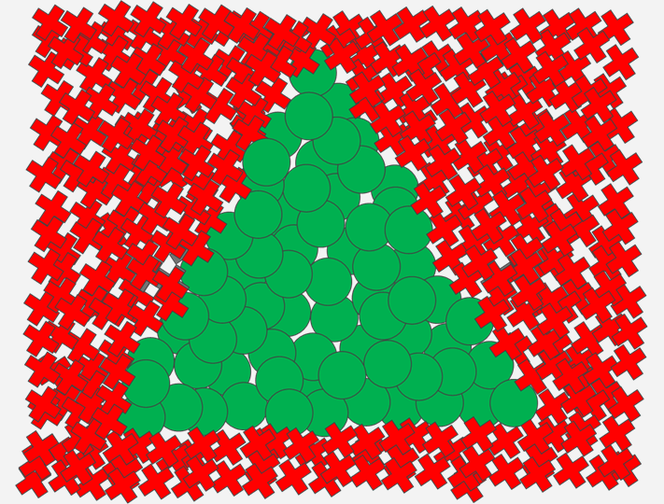
???
Model

Slide 48
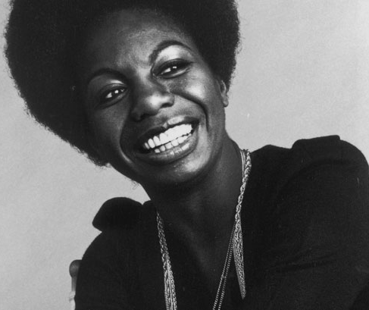
Model
Notes:
34m-35m

Slide 49
Model

Slide 50
Model
Duplicated Model

Slide 51

Model
Duplicated Model

Slide 52
Model
Duplicated Model
Queries to Get To 99% Accuracy = ???????
Notes:
34m-35m

Slide 53
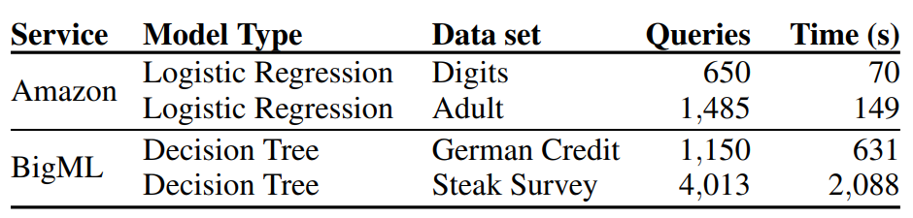

Slide 54
Model Extraction Attack

Slide 55
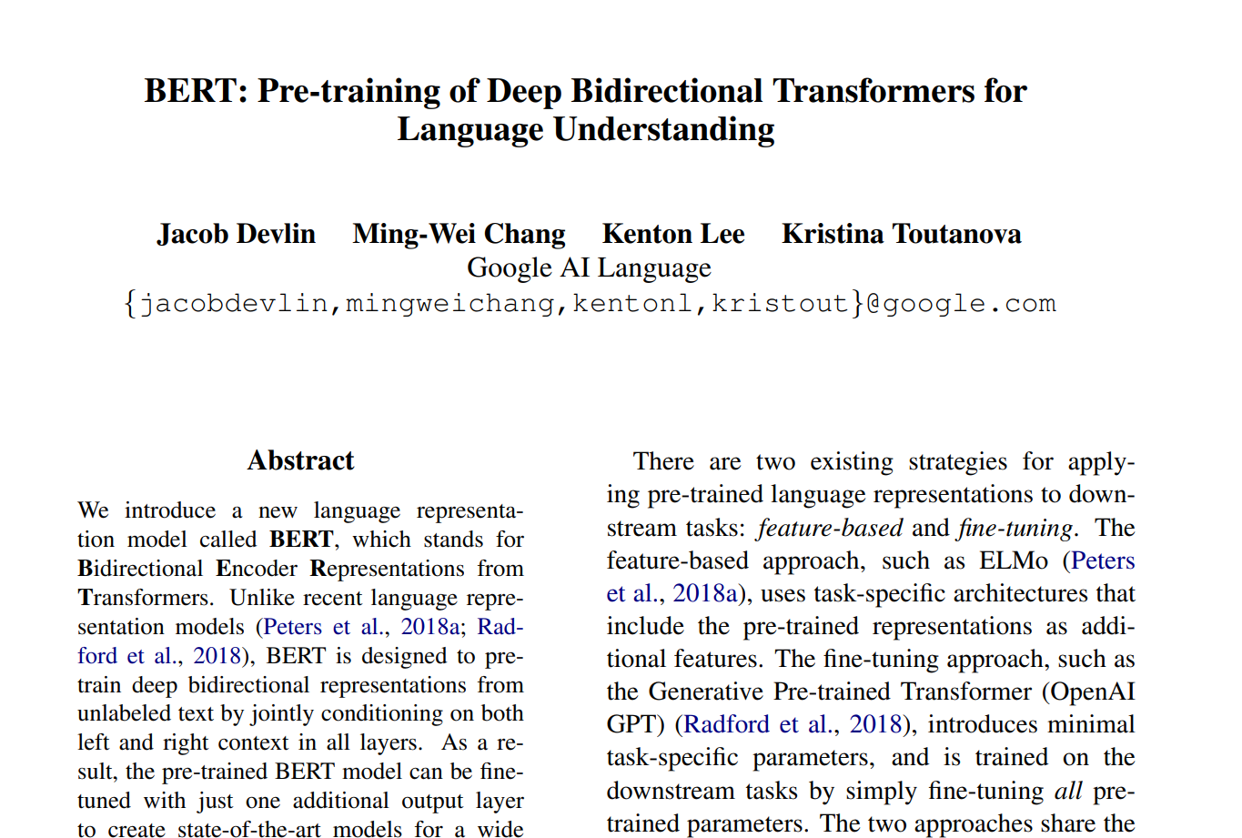
Language Models
BERT: Pre-training of Deep Bidirectional Transformers for Language Understanding - Devlin, Chang, Lee, Toutanova

Slide 56
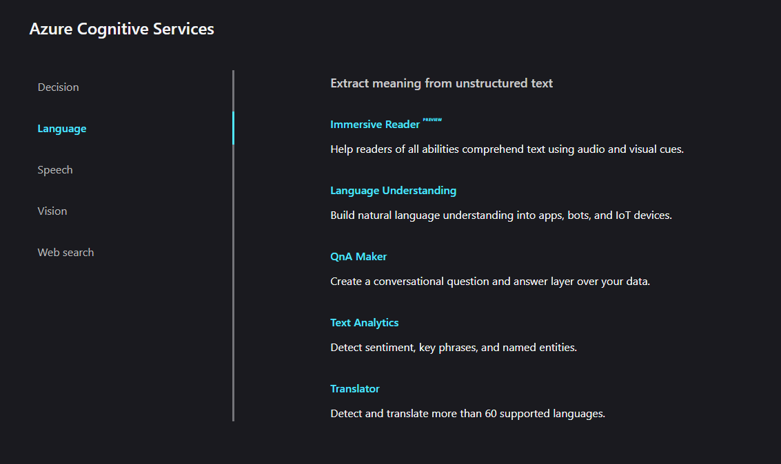
Language Models

Slide 57
SQuaD Tests
SQuAD = Stanford Question Answering Dataset
Reading comprehension dataset
Questions posed against Wikipedia articles
Answer is question is a segment of text, or span (or unanswerable).
Journalist Nik Cohn described him as "rock's greatest ever natural talent". His singing abilities encompassed a wide range from falsetto to baritone and rapid, seemingly effortless shifts of register. Prince was renowned as a multi-instrumentalist. He is considered a guitar virtuoso, a master of drums, percussion, bass, keyboards, and synthesizer. On his first 5 albums, he played nearly all the instruments, including 27 instruments on his debut album, among them various types of bass, keyboards and synthesizers.
Journalist Nik Cohn described him as "rock's greatest ever natural talent". His singing abilities encompassed a wide range from falsetto to baritone and rapid, seemingly effortless shifts of register. Prince was renowned as a multi-instrumentalist. He is considered a guitar virtuoso, a master of drums, percussion, bass, keyboards, and synthesizer. On his first 5 albums, he played nearly all the instruments, including 27 instruments on his debut album, among them various types of bass, keyboards and synthesizers.
Wikipedia
Q: How many instruments did Prince play?
A: 27.

Slide 58
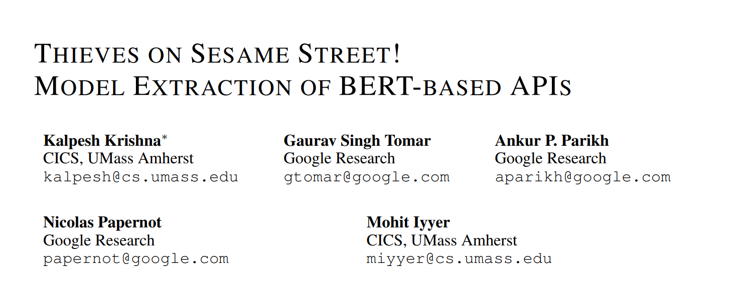
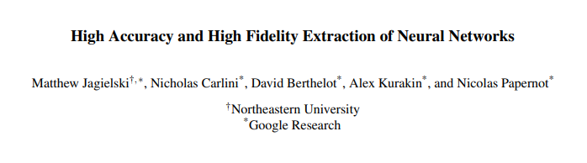
The Attack
Notes:
https://arxiv.org/pdf/1910.12366.pdf
https://arxiv.org/pdf/1909.01838.pdf

Slide 59
The Attack
Journalist Nik Cohn described him as "rock's greatest ever natural talent". His singing abilities encompassed a wide range from falsetto to baritone and rapid, seemingly effortless shifts of register. Prince was renowned as a multi-instrumentalist. He is considered a guitar virtuoso, a master of drums, percussion, bass, keyboards, and synthesizer. On his first 5 albums, he played nearly all the instruments, including 27 instruments on his debut album, among them various types of bass, keyboards and synthesizers.
Journalist Nik Cohn described him as "rock's greatest ever natural talent". His singing abilities encompassed a wide range from falsetto to baritone and rapid, seemingly effortless shifts of register. Prince was renowned as a multi-instrumentalist. He is considered a guitar virtuoso, a master of drums, percussion, bass, keyboards, and synthesizer. On his first 5 albums, he played nearly all the instruments, including 27 instruments on his debut album, among them various types of bass, keyboards and synthesizers.
Journalist Nik Cohn described him as "rock's greatest ever natural talent". His singing abilities encompassed a wide range from falsetto to baritone and rapid, seemingly effortless shifts of register. Prince was renowned as a multi-instrumentalist. He is considered a guitar virtuoso, a master of drums, percussion, bass, keyboards, and synthesizer. On his first 5 albums, he played nearly all the instruments, including 27 instruments on his debut album, among them various types of bass, keyboards and synthesizers.
Wikipedia
RANDOM.
Q: How workforce. Stop who new of Jordan et Wood, displayed the?
A: His singing abilities encompassed a wide range.
WIKI ­­
Q: keyboards a as Nik baritone Cohn Prince on shifts multi-instrumentalist. virtuoso, is 5
A: On his first 5 albums.

Slide 60
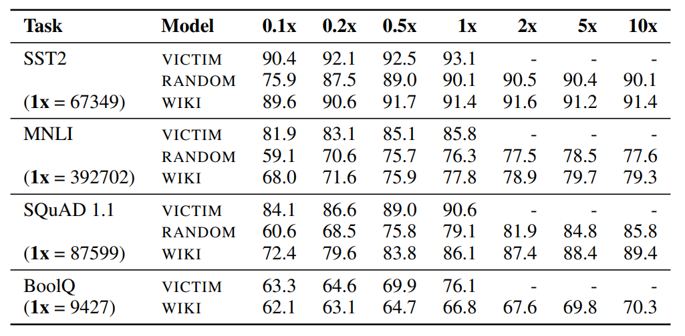
The Attack
The Cost
$62.35 => sentiments on 67,000 sentences
$430.56 => speech recognition dataset of 300 hours
$2,000 => 1M translation queries (each with 100 characters)

Slide 61
Using MLOps to Defend
Possible defenses
Detecting queries that could be part of an attack
Watermarking predictions made by the API
REPEAT: The pipeline is the value not the model
Improving domain specificity
Continuous retraining for accuracy
Faster throughput & SLA
If you REALLY need model security, treat accessing your model like accessing source code
Realistically, if you allow arbitrary access to a model endpoint, it WILL be stolen
(if it’s worth it)

Slide 62
Tools to Defend
Spend the Majority of Engineering Here
Not Here
Train Data
Ingest
Engineer & Split
Train
Serve
Test Data

Slide 63
Three Types of Attacks We’ll Talk About Today
Attacker Gets Your ML to Lie To You
Attacker Takes Your Models
Attacker Finds Out About Hidden Data

Slide 64
Three Types of Attacks We’ll Talk About Today
Attacker Gets Your ML to Lie To You
Attacker Takes Your Models
Attacker Finds Out About Hidden Data

Slide 65
Attacker Finds Out About Hidden Data

Slide 66
Motivation
Malicious user wants to find out hidden data
Can be for system or users information
Probes model using public endpoints
Does NOT have to be logged in (but it helps)
Tough to defend against - looks VERY similar to user behavior
You were probably already having this problem, it just became obfuscated (more) by ML

Slide 67
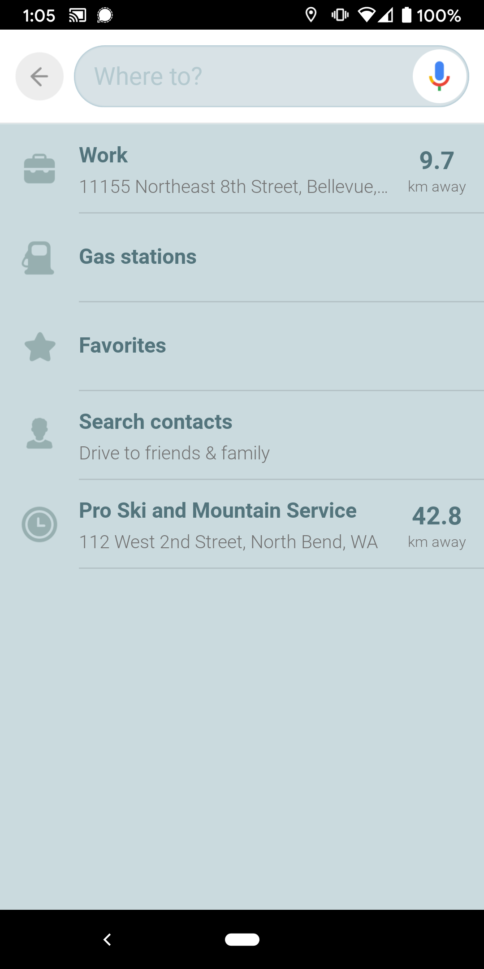
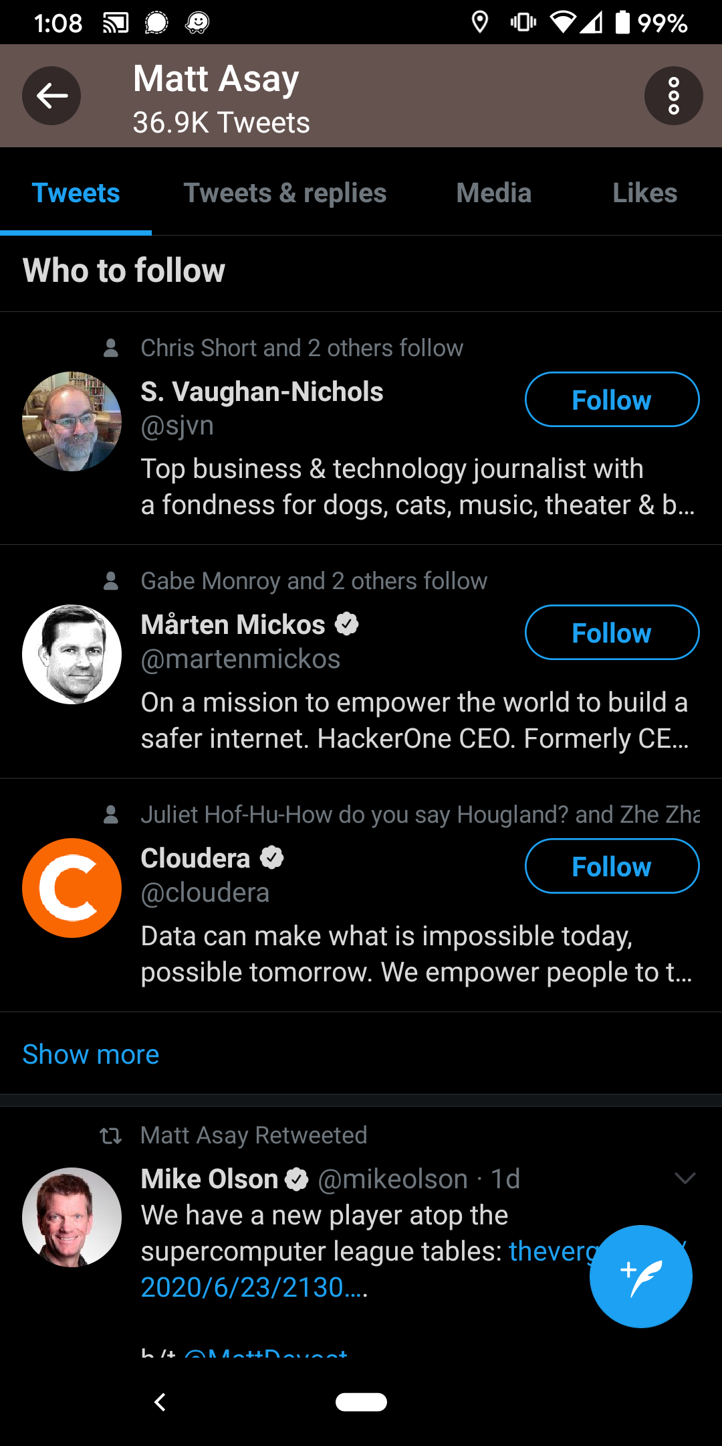
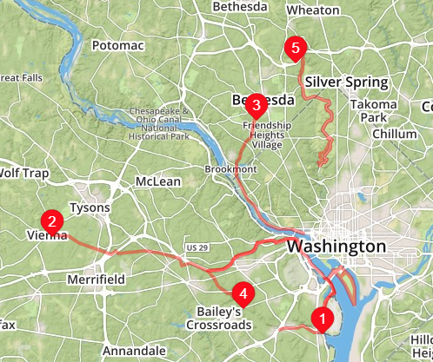
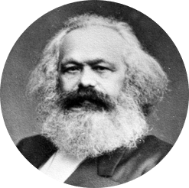
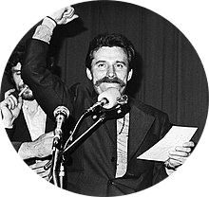
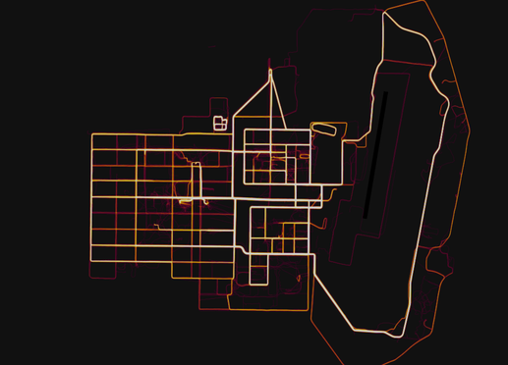

Hidden Data Leakage Examples
Recommendations
Network Graph
Maps
César Estrada Chávez and 9 others follow
Karl M.
@KarlMarx
Fidel-Castro and 3 others follow
Lech Walesa
@LechWalesa
Friedrich Engels and 4 others follow
Unionize Meeting
Pravda
@Pravda
My Historical Events
My Friend’s Graphs
The Community’s Locations

Slide 68
There’s Nothing So Bad that It Can’t Be Worse

Slide 69
There’s Nothing So Bad that It Can’t Be Worse (Especially with ML)

Slide 70
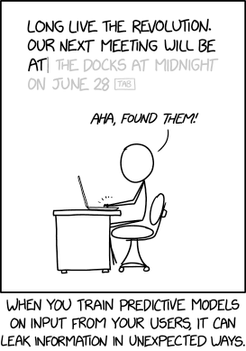
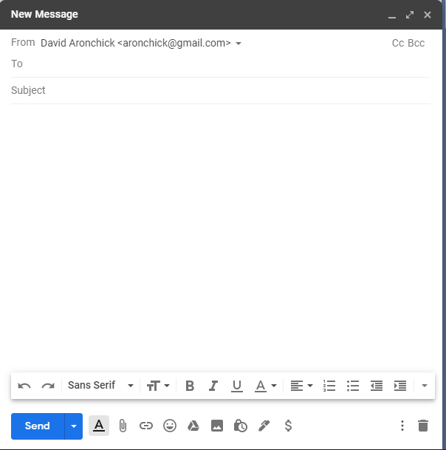
Secret Memorization
Let the ruling classes
tremble at a Communistic revolution. The proletarians have nothing to lose but their chains. They have a world to win.
Comes from your corpus of (probably private) data!
Notes:
https://xkcd.com/2169/

Slide 71
Secret Memorization
Address: My shipping address is 1101 NE 25th St, #168, Seattle WA 98004
Phone number: Can you call me at 212 555-1212
Relationship info: We are planning to visit next week. My partner, Ashley, and I are...
Credit card: Please put it on my Visa, 4128 1234 5678 9012
SSN: My social security number is… 262-97-7277

Slide 72
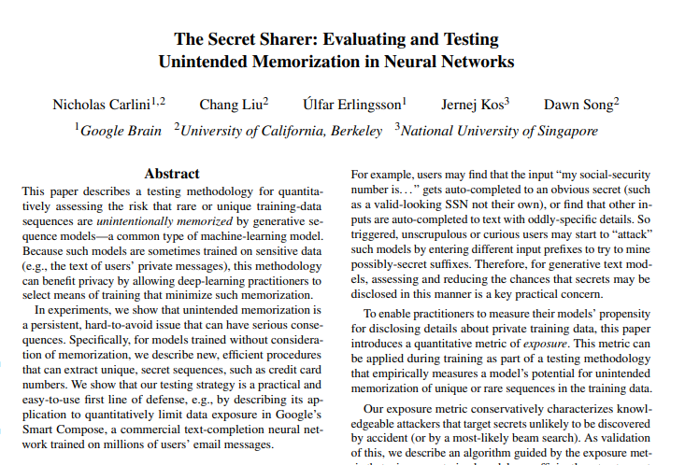
Secret Memorization
The Secret Sharer: Evaluating and Testing Unintended Memorization in Neural Networks Carlini, Liu, Erlingsson, Kos, Song

Slide 73
Secret Memorization
Inject Canary:
“The random number is 0123456789.”
Train Data
Ingest
Engineer & Split
Train
Serve
Test Data
Test for Leakage:
“The random number is ?????????.”

Slide 74




Secret Memorization
Train Data
Ingest
Engineer & Split
Train
Serve
Test Data
Differential Privacy

Slide 75
Don’t Wait For Technology to Solve!
There will be advances, but…
Ultimately, SOME WILL LEAK
The point of these models is to generate new text
New text that ‘feels right’ will be based on the user’s corpus
That’s data leakage!
Key step: Build a pipeline!
Lets you understand exposure
Lets you react quickly if necessary
Lets you augment with new tools quickly

Slide 76
Summary

Slide 77
MLOps Gives* You…
Software best practices for building machine learning solutions
Repeatable workflow for training a model and rolling it out to production
An immutable record of what’s actually running
Lineage of model creation including data sources
Acceleration from code to customer benefits
* Requires some human and software work

Slide 78

It’s a whole new world
Data science will touch EVERY industry.
We can’t ask people to become a PhD in statistics though.
How do WE help everyone take advantage of this transformation?

Slide 79
Truths You Cannot Avoid
You WILL be attacked
Your pipeline WILL have issues
The game is all about mitigation of harms (and quick recovery)

Slide 80
me: David Aronchick
twitter: @aronchick
apps: http://mlops-github.com/
“Why Should I Trust You?” Explaining the Predictions of Any Classifier - Ribeiro, Singh, Guestrin
Synthesizing Robust Adversarial Examples - Anish Athalye, Logan Engstrom, Andrew Ilyas, Kevin Kwok
Accessorize to a Crime: Real and Stealthy Attacks on State-of-the-Art Face Recognition - Sharif, Bhagavatula, Bauer, Reiter
How To Backdoor Federated Learning - Bagdasaryan, Veit, Hua, Estrin, Shmatikov
Learning to Detect Malicious Clients for Robust Federated Learning - Li, Cheng, Wang, Liu, Chen
“High Accuracy and High Fidelity Extraction of Neural Networks” - Jagielski, Carlini, Berthelot, Kurakin, Papernot
‘Thieves on Sesame Street! Model Extraction of BERT-based APIs’ - Krishna, Tomar, Parikh, Papernot and Iyyer
BERT: Pre-training of Deep Bidirectional Transformers for Language Understanding - Devlin, Chang, Lee, Toutanova
The Secret Sharer: Evaluating and Testing Unintended Memorization in Neural Networks Carlini, Liu, Erlingsson, Kos, Song
THANK YOU!

